Slide 1
GREEN FUTURE

Slide 2
TEACHING SUSTAINABILITY

Slide 3
Sustainable development
1987 Brundtland report “Our Common Future”
development that meets the needs of the present without compromising the ability of future generations to meet their own needs
it seeks to reconcile economic development with the protection of social and environmental balance
Notes:
What is sustainability? What do we want to sustain? An important part of teaching sustainability issues involves keeping these questions always open and alive. Sustainability offers a novel framework for asking enduring philosophical questions: What is the good life? How do we create a better world?
Thinking and teaching about sustainability are future-oriented projects, but the relevance of sustainability principles and practices must be articulated in the present.
The term “sustainability” has an important history in development literature. In 1983, the United Nations convened the World Commission on Environment and Development (WCED), known informally by the name of its chair, Gro Harlem Brundtland. The Brundtland Comission’s report, Our Common Future (1987), contains one of the most often cited definitions of sustainability:
“Sustainable development is development that meets the needs of the present without compromising the ability of future generations to meet their own needs. It contains within it two key concepts:
• the concept of ‘needs’, in particular the essential needs of the world’s poor, to which overriding priority should be given; and
• the idea of limitations imposed by the state of technology and social organization on the environment’s ability to meet present and future needs.”

Slide 4
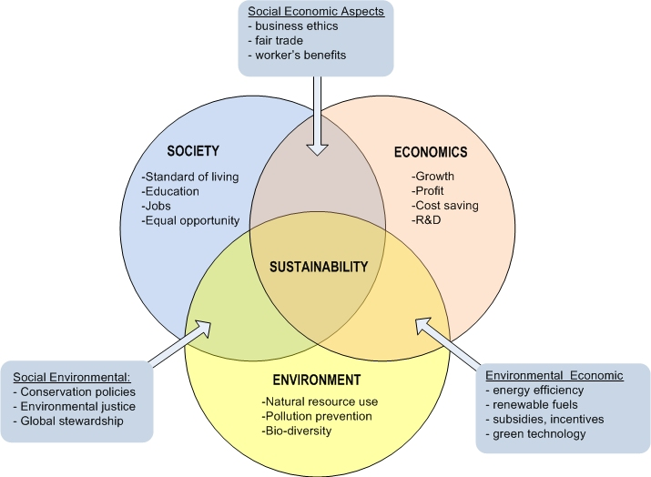
Notes:
The scope of sustainability is frequently described as including three spheres – social, environmental, and economic. To use an accounting metaphor, sustainability projects must be evaluated according to a “triple bottom line” of social, environmental, and economic responsibility. A Venn diagram depicts the interdisciplinarity of sustainability as a field of inquiry.
The interaction of the three pillars of sustainability
Consider:
Environmental and economic sustainability combine to make everyone’s living conditions viable—until social unrest overwhelm them.
Environmental and social sustainability combine to make everyone’s living conditions bearable—until they run out of money to keep it all going.
Economic and social sustainability combine to make everyone’s living conditions equitable—until the environment degrades to where Earth can’t sustain human life.
Sustainable living conditions require the intersection of all three facets.
What are the three pillars of sustainable development? (business perspective)
Social pillar
The social pillar of a company's sustainable development refers to values that promote equality and respect for individual rights. The social consequences of the company's social activity are then assessed in accordance to these issues, such as gender equality.
The principles upon which this pillar is founded are as follows:
Combat social exclusion and discrimination: helping with reintegration, supporting gender equality, reducing the gender pay gap, promoting training, encouraging dialogue, and applying global social rights. In other words, the goal is to seek to aid the global population.
Promote solidarity: helping to reduce social inequalities by collaborating with local and international associations and projects, and prioritizing fair trade products which guarantee an appropriate income for farmers and help to promote sustainable agriculture.
Contribute to the well-being of stakeholders: developing social dialogue, encouraging the exchange of information and transparency, adapting working hours according to employee profile, and making premises accessible to people with reduced mobility.
Economic pillar
This pillar is based on companies’ ability to contribute to economic development and growth. In other words, they must encourage and promote the protection of the environment by limiting the risks posed by their production. The recycling of products and the use of renewable energy are therefore fundamental aspects of the development of the economic pillar.
Furthermore, the ISO 50001 standard which is focused on energy efficiency, aims to improve energy performance, with a view to reducing energy consumption and therefore contributing to economic growth. Effectively implementing of this standard leads to a certification, serving as a guarantee of optimal, affordable and clean energy use.
Environmental pillar
The environmental pillar is founded on a commitment to protect the environment by reducing risks and measuring the environmental impacts of companies' activities. The challenges for companies in this area are as follows:
Saving and preserving natural energy or agricultural resources
Assessing their carbon footprint and reducing total greenhouse gas emissions and further achieve sustainable development goals.
Prevent water scarcity and reduce overall waste for current and future generations.
Companies must set targets to improve their performance on environmental issues. These goals are an integral part of Corporate Social and Environmental Responsibility (CSER).

Slide 5
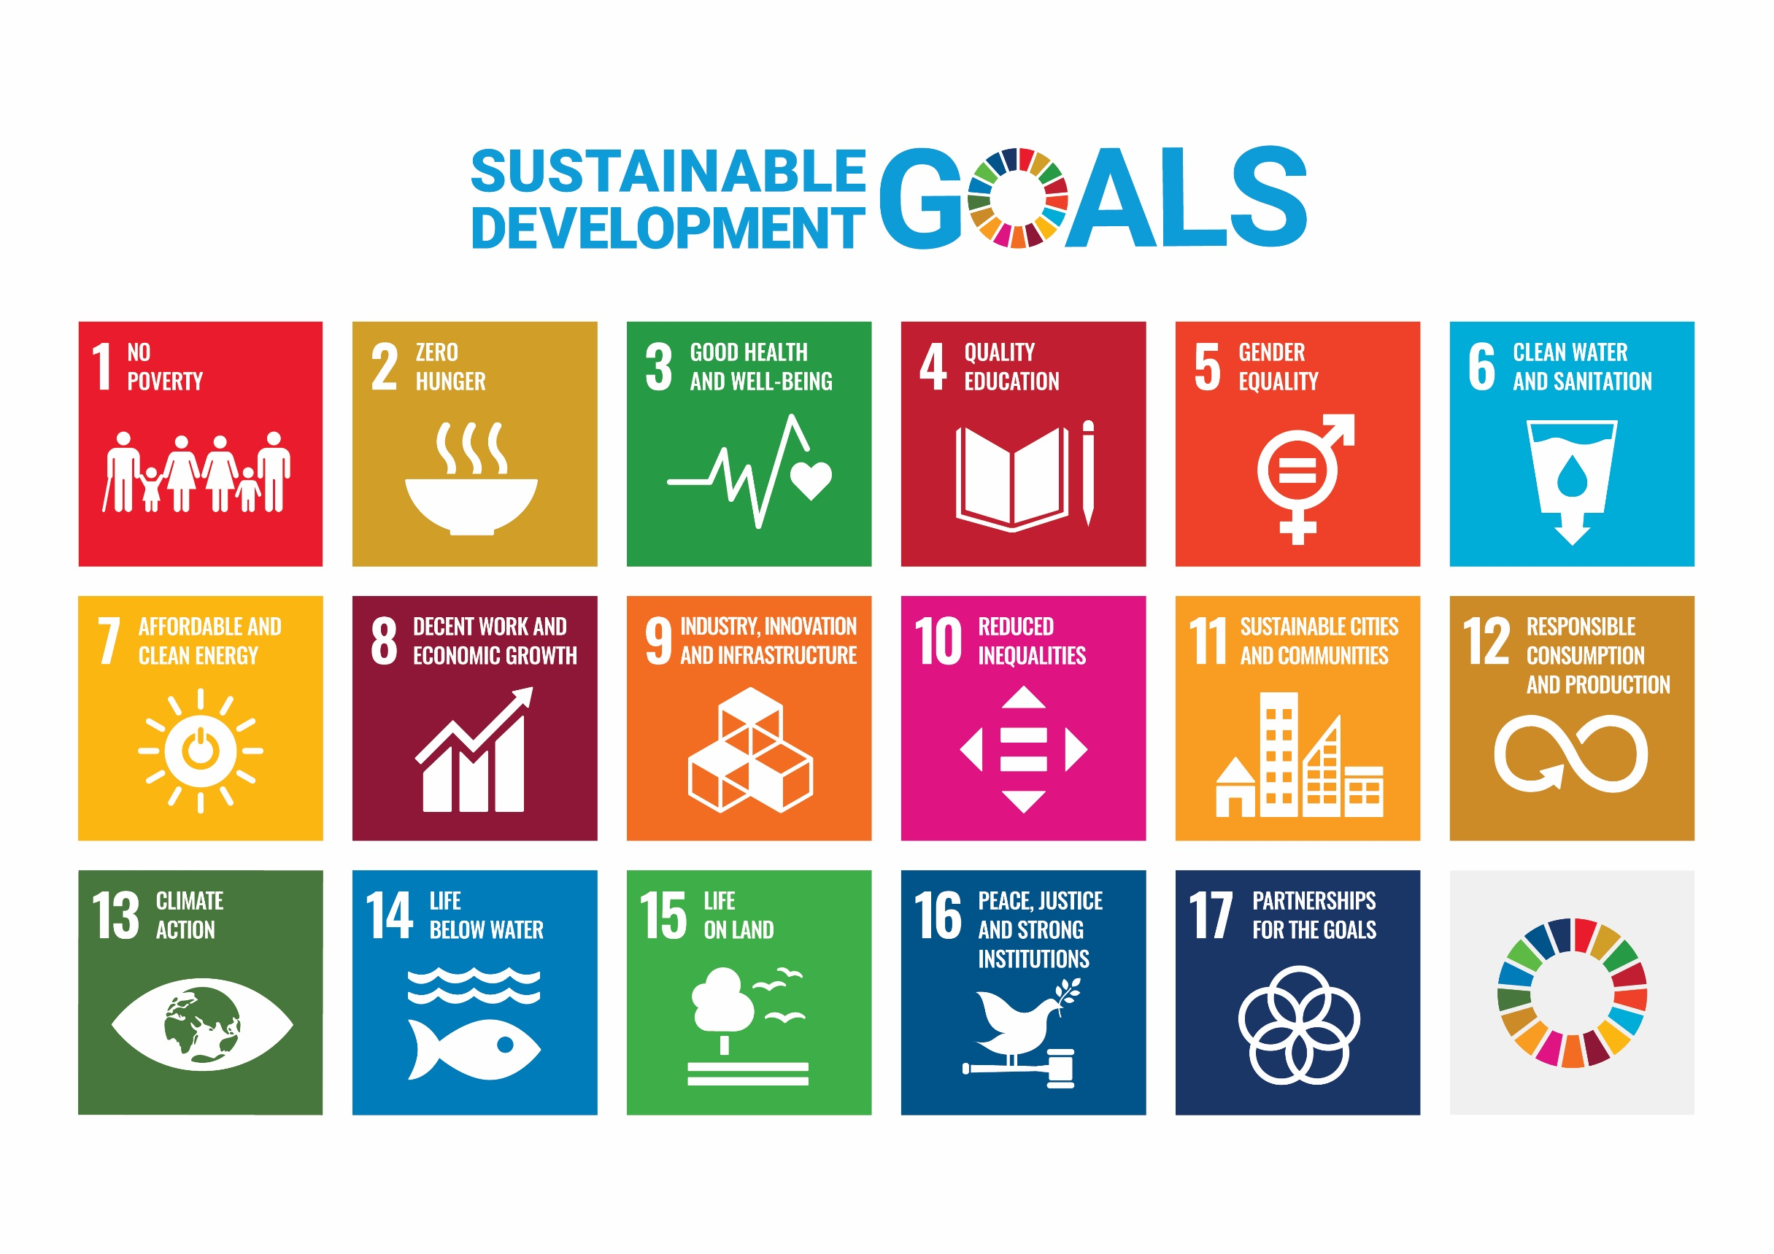
Notes:
History
The 2030 Agenda for Sustainable Development, adopted by all United Nations Member States in 2015, provides a shared blueprint for peace and prosperity for people and the planet, now and into the future. At its heart are the 17 Sustainable Development Goals (SDGs), which are an urgent call for action by all countries - developed and developing - in a global partnership. They recognize that ending poverty and other deprivations must go hand-in-hand with strategies that improve health and education, reduce inequality, and spur economic growth – all while tackling climate change and working to preserve our oceans and forests.
The SDGs build on decades of work by countries and the UN, including the UN Department of Economic and Social Affairs
In June 1992, at the Earth Summit in Rio de Janeiro, Brazil, more than 178 countries adopted Agenda 21, a comprehensive plan of action to build a global partnership for sustainable development to improve human lives and protect the environment.
Member States unanimously adopted the Millennium Declaration at the Millennium Summit in September 2000 at UN Headquarters in New York. The Summit led to the elaboration of eight Millennium Development Goals (MDGs) to reduce extreme poverty by 2015.
The Johannesburg Declaration on Sustainable Development and the Plan of Implementation, adopted at the World Summit on Sustainable Development in South Africa in 2002, reaffirmed the global community's commitments to poverty eradication and the environment, and built on Agenda 21 and the Millennium Declaration by including more emphasis on multilateral partnerships.
At the United Nations Conference on Sustainable Development (Rio+20) in Rio de Janeiro, Brazil, in June 2012, Member States adopted the outcome document "The Future We Want" in which they decided, inter alia, to launch a process to develop a set of SDGs to build upon the MDGs and to establish the UN High-level Political Forum on Sustainable Development. The Rio +20 outcome also contained other measures for implementing sustainable development, including mandates for future programmes of work in development financing, small island developing states and more.
In 2013, the General Assembly set up a 30-member Open Working Group to develop a proposal on the SDGs.
In January 2015, the General Assembly began the negotiation process on the post-2015 development agenda. The process culminated in the subsequent adoption of the 2030 Agenda for Sustainable Development, with 17 SDGs at its core, at the UN Sustainable Development Summit in September 2015.
2015 was a landmark year for multilateralism and international policy shaping, with the adoption of several major agreements:
Sendai Framework for Disaster Risk Reduction (March 2015)
Addis Ababa Action Agenda on Financing for Development (July 2015)
Transforming our world: the 2030 Agenda for Sustainable Development with its 17 SDGs was adopted at the UN Sustainable Development Summit in New York in September 2015.
Paris Agreement on Climate Change (December 2015)
Now, the annual High-level Political Forum on Sustainable Development serves as the central UN platform for the follow-up and review of the SDGs.
Today, the Division for Sustainable Development Goals (DSDG) in the United Nations Department of Economic and Social Affairs (UNDESA) provides substantive support and capacity-building for the SDGs and their related thematic issues, including water, energy, climate, oceans, urbanization, transport, science and technology, the Global Sustainable Development Report (GSDR), partnerships and Small Island Developing States. DSDG plays a key role in the evaluation of UN systemwide implementation of the 2030 Agenda and on advocacy and outreach activities relating to the SDGs. In order to make the 2030 Agenda a reality, broad ownership of the SDGs must translate into a strong commitment by all stakeholders to implement the global goals. DSDG aims to help facilitate this engagement.
Implementation Progress
Every year, the UN Secretary General presents an annual SDG Progress report, which is developed in cooperation with the UN System, and based on the global indicator framework and data produced by national statistical systems and information collected at the regional level.

Slide 6
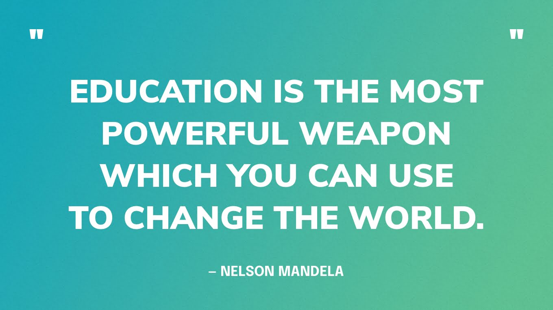
Notes:
Discussion
First, what change do we want to achieve?
Second, how do we teach young people to inspire them to be part of the change towards better future?
Could teaching sustainability actually backfire? What should we avoid?
What level of environmental awareness do your students represent?
What is your students attitude towards sustainability?
How can you include topics related to sustainability in your classroom?

Slide 7
TEACHERS AS AGENTS OF CHANGE
Creating a positive learning environment
Encouraging innovation and experimentation
Advocating for change
Providing mentorship and guidance
Fostering a sense of community
Incorporating technology into the classroom
Encouraging student leadership and empowerment
Collaborating with colleagues and other stakeholders
Notes:
Teachers are the backbone of any educational system. They are responsible for providing the knowledge, skills, and values that students need to succeed in life. However, their role goes beyond just imparting knowledge. Teachers are also agents of change in schools, responsible for shaping the culture, policies, and practices of the educational institution they work in.
Creating a Positive Learning Environment
One of the most important ways in which teachers can act as agents of change in schools is by creating a positive learning environment. This involves creating a classroom culture that fosters creativity, critical thinking, and collaboration among students.
Teachers can achieve this by modeling the behaviors they want to see in their students. They can encourage curiosity, a love of learning, and a growth mindset by demonstrating these traits themselves. Teachers can also encourage students to take risks, make mistakes, and learn from them. By creating a safe and supportive environment where students feel comfortable to take risks and learn from their mistakes, teachers can help their students to develop resilience and the confidence to tackle challenges head-on.
Encouraging Innovation and Experimentation
Teachers can also act as agents of change in schools by encouraging innovation and experimentation. This involves providing opportunities for students to try new things, explore new ideas, and develop their creativity.
By providing students with opportunities for experimentation and exploration, teachers can help them to develop a sense of curiosity and an eagerness to learn. They can also help students to develop problem-solving and critical thinking skills by encouraging them to think outside the box and come up with new and innovative solutions to problems.
Promoting Social and Emotional Learning
Another important way in which teachers can act as agents of change in schools is by promoting social and emotional learning. This involves teaching students how to manage their emotions, build relationships, and develop empathy.
By helping students to develop these skills, teachers can create a safe and supportive learning environment where students feel valued and supported. This, in turn, can help students to develop a sense of belonging and connection to their school community, which is essential for their academic and personal success.
Advocating for Change
Teachers can also act as agents of change in schools by advocating for change. This could involve promoting policies and practices that support student well-being and academic achievement, or advocating for changes in school culture and curriculum.
For example, a teacher might advocate for a new policy that allows students to take mental health days when they need them. Or, they might advocate for a change in the curriculum that better reflects the needs and interests of their students.
Providing Mentorship and Guidance
Finally, teachers can act as agents of change in schools by providing mentorship and guidance to their students. This involves serving as a role model and providing guidance and support as students navigate their academic and personal lives.
By providing mentorship and guidance, teachers can help students to develop confidence and resilience, and to overcome obstacles and challenges that may arise. They can also help students to develop a sense of purpose and direction, which is essential for their long-term success.
Fostering a sense of community
Teachers can act as agents of change by fostering a sense of community among their students. This involves encouraging collaboration, teamwork, and mutual support among students, and helping students to feel like they are part of a larger community that cares about their well-being and success.
Emphasizing the importance of diversity and inclusion
Teachers can act as agents of change by emphasizing the importance of diversity and inclusion in the classroom and beyond. By promoting a culture of respect and understanding for different cultures, backgrounds, and perspectives, teachers can help their students develop the skills they need to navigate an increasingly diverse and interconnected world.
Incorporating technology into the classroom
Teachers can act as agents of change by incorporating technology into the classroom in innovative and effective ways. By using technology to enhance student learning and engagement, teachers can help their students develop the digital literacy skills they need to succeed in the 21st century.
Encouraging student leadership and empowerment
Teachers can act as agents of change by encouraging student leadership and empowerment. By giving students opportunities to take on leadership roles, make decisions, and have a voice in the classroom and school community, teachers can help their students develop the skills and confidence they need to be effective leaders and change-makers in their own right.
Collaborating with colleagues and other stakeholders
Finally, teachers can act as agents of change by collaborating with their colleagues and other stakeholders to effect positive change in their schools. By working together to identify areas for improvement, sharing best practices, and advocating for change at the school and district level, teachers can create a more effective and responsive educational system that better serves the needs of all students.
Conclusion
In conclusion, teachers are crucial agents of change in schools. They play a vital role in shaping the minds and character of their students, and in creating a positive and supportive learning environment where students can thrive.
Teachers can act as agents of change in schools by creating a positive learning environment, encouraging innovation and experimentation, promoting social and emotional learning, advocating for change, and providing mentorship and guidance to their students.
As we continue to navigate the challenges of a rapidly changing world, it is more important than ever for teachers to act as agents of change in their schools, and to work together to create a brighter future for our students.

Slide 8
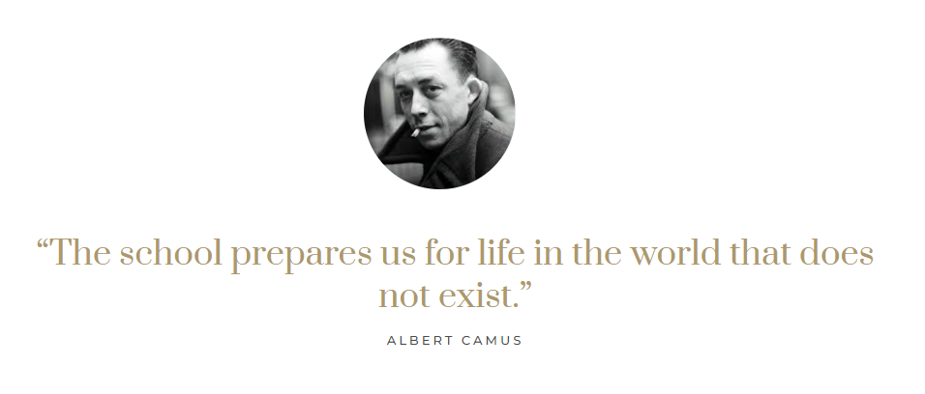
Notes:
Education should not be a waiting room for life
Prepare for life, not for tests

Slide 9
Teaching sustainability in classroom
Beware of student overload.
Avoid doom and gloom.
Focus on quality of life issues.
Peer engagement and support.
Student analysis of data.
Deconstruct eco-rhetoric.
Precautionary principle.
Embrace interdisciplinarity.
Notes:
Beware of Student Overload. The rhetoric of urgent and global environmental crises can overwhelm students when they consider the immensity of the problems humanity face and the difficulties involved in coping with them. These feelings of cognitive or emotional overload can cause students to feel disengaged, disempowered, and even resentful, which can disrupt the learning process.
Avoid Doom and Gloom. While teaching students about the many challenges to environmental sustainability will necessarily introduce some risk of overload, teachers can limit this by being sure to discuss environmental success stories. For example, this may include discussion of environmental policies or movements that have succeeded in mitigating pollution, conserving resources, or promoting ecological resiliency. Whatever the success, incorporating them into courses can help students envision a future that is shaped by their agency, and avoid any descent into cynical resignation or fearful reaction.
Focus on Quality of Life Issues. Students facing the emotional overload of environmental problems can easily feel that their entire lifestyle is threatened by resource limits and the environmentalists who champion living simply. Educators can sometimes add to this sense of threat by taking a moralizing, prescriptive, and unyielding approach to more sustainable lifestyles. An alternative approach is to engage students by discussing their definitions of happiness and a quality of life, and whether they are correlated with high levels of consumption and resource use. If students reflect prior research findings (Consumerism and its Discontents, To Do or to Have? That Is the Question), they will often argue that the two are not highly correlated, providing a basis for a positive discussion of alternative lifestyles and social changes associated with them.
Peer Engagement and Support. Engaging students in group discussions and projects in which they have the opportunity to dialogue and support one another can help to alleviate these feelings of overload. It also can allow for the moments of problem-solving, debate, analysis, teamwork, and reflection that are so crucial to developing the critical thinking and leadership skills students need to face complex problems.
Student Analysis of Data. Students may learn more about a given environmental problem by wrestling with empirical data for themselves, rather than receiving pre-digested analyses from lectures or secondary sources. In doing so, they will not only grapple with methodological and theoretical issues of data analysis and presentation, but they will be empowered to examine environmental issues with greater nuance and insight.
Deconstruct Eco-rhetoric. Spend time investigating the historical origins and often conflicting uses of environmental terminology such as “sustainability,” “environmentalism,” “stewardship,” “nature” itself, and other language. This will provide valuable teaching moments about the historical development of environmental studies, and it will empower students to examine environmental problems and solutions more critically.
Precautionary Principle. Succinctly defined, the precautionary principle states that, if an action risks causing harm to the public or the environment, and there is no scientific consensus that it is indeed harmful, the burden of proof that it is NOT harmful falls on those taking the action. An often debated principle, it provides a useful starting point for class discussions of how to make decisions under conditions of uncertainty. It also offers an opportunity to discuss policy options regarding resource use and the tradeoffs between potential environmental harm on the one hand, and economic or political costs on the other.
Embrace Interdisciplinarity. A critical and thorough understanding of issues related to environmental sustainability necessarily involves contributions from a wide variety of disciplines throughout the natural sciences, social sciences, and humanities. This may be daunting for students and educators alike since it often requires us to think outside of our intellectual expertise. Doing interdisciplinarity well can be a challenge, but it becomes easier with a more effective use of resources on one’s campus community and beyond, such as team teaching with a colleague from a different discipline, organizing guest lecturers from across campus, or bringing in guest speakers from the local community. Mostly, however, it requires a courage to step out of one’s comfort zone and explore topics that will enrich the learning experience for our students and that will stimulate us to think in new ways as educators.

Slide 10
Gen Z traits
Sense of crisis, high depression and anxiety rates
Angry, not afraid to speak up
They are told they’re special and they believe it
Digital natives, technology and social media savvy
Multi taskers
Progressive, pursue to make changes in society
Purpose oriented, pragmatic
Desire to contribute to a good cause
Value authenticity and fashion style
Short attention span
Want immediate feedback
Notes:
Teaching Strategies for Gen Z?
Think Digital in all assignments, assessments, activities
Break content into short segments
Make information graphical and bite size
Rethink how you communicate
Be relevant. Respect the time of the Gen Z student
Provide individualized instruction - think adaptive learning
Use Social Media approaches to learning
Set up students for a career
Provide access to resources to help eliminate student loan debt
Acknowledge that this generation sees themselves as Smart, Creative, and Hardworking
Most Helpful Online Classroom Tools for Gen-Z Student Learning:
Barnes & Noble Report
Class Discussion 64%
Working through problems and concepts 60%
Study Guides 60%
Textbooks 56%
Test Review Sessions 52%
Working in Small Groups 49%
Homework 46%
Notes Made Available Online 38%
(https://next.bncollege.com/wp-content/uploads/2015/10/Gen-Z-Research-Report-Final.pdf)
Learning Preferences
Generation Z: craves regular and technology-enhanced training opportunities. Looks for professional development that uses visually enhanced methods of training.
Short online quizzes: Generation Z students prefer to answer short, online exams. In my classes, I upload quizzes on Blackboard and my students answer these short quizzes in the classroom—they use their cellphones to do this.
Teams/small groups: According to Rothman (2018), Generation Z prefers to work in small groups. When they work in small groups, they can foster more creativity. In my writing course, my students have written excellent narrative paragraphs using themselves as characters of a story. During the process, you can see how much they enjoy this exercise by their enthusiasm as they share their final product with their classmates.
Active learning activities: Research has identified that Generation Z has a short attention span. One approach that I use is writing a short summary in teams or individually. This activity helps me identify what needs to be reviewed. Also, “One Minute Papers” are very effective for this purpose.
Games: Games are very effective to review material and allow students to share knowledge. Students can become very active and put forth a lot of concentration on the game. Generation Z students are virtual gamers, and they love game challenges.
Caring and feedback: This is the most important strategy. When we care about what is happening to our students and their needs, students become more engaged in the classroom. Caring about their progress gives them constant and positive feedback. Although we may correct their papers, we give them feedback on how they can improve, and we motivate them by giving them encouragement. Positive words change people, and we need to do this with our students.

Slide 11
Inspiring action in Gen Z
Sharing success stories
Influencers and celebrity activists
Apps and games
Notes:
https://www.plt.org/story/young-environmentalists-examples/
https://unity.edu/hybrid-learning/16-young-environmentalists-changing-the-world/

Slide 12
Inspiring action in Gen Z
Sharing success stories:
Stories of peers who accomplished their goals, such as creating an NGO, influencing politics, running awareness campaigns, inventing technological solutions to environmental problems etc.
Ask your students to research a local activist and find out what they have achieved.

Slide 13

2019 African drama based on true story of a thirteen-year-old boy in Malawi, William Kamkwamba, who designs and builds a windmill to save his family and village from famine.

Slide 14
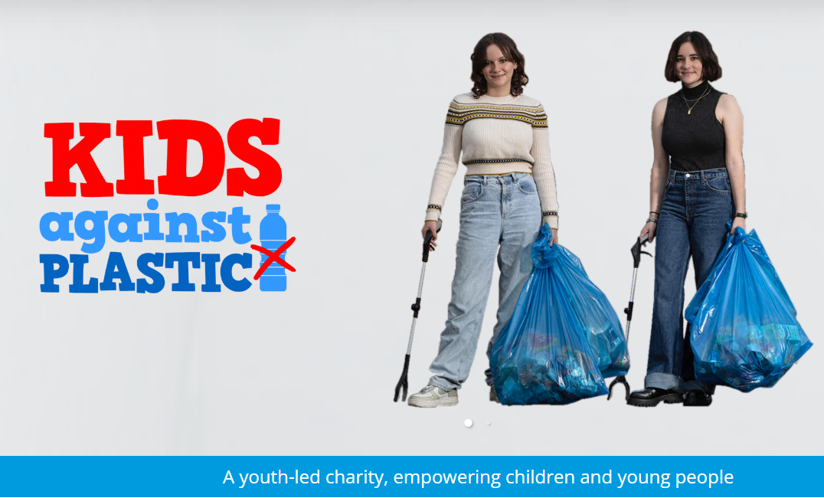
Ella and Amy Meek
Notes:
Ella and Amy Meek
Amy Meek co-founded Kids Against Plastic with her sister Ella, at the ages of 12 and 10, respectively, in 2016. The UK-based duo are anything but meek when it comes to the fight against plastic pollution. They have since picked up more 90,000 pieces of single-use plastic litter, launched campaign initiatives with over 1000 schools and over 50 cafés, businesses, and festivals, and even published a book Be Plastic Clever in 2020. Amy shares how their educational initiatives raise awareness on plastic pollution, and ways in which children can get involved in helping make the world a better place.

Slide 15
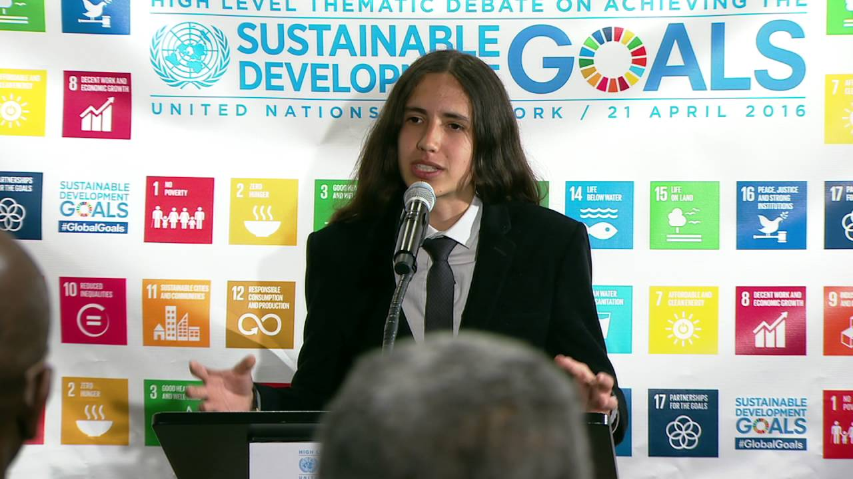
Xiuhtezcatl Martinez
(pronounced 'Shoe-Tez-Caht')
Notes:
Xiuhtezcatl Martinez
Xiuhtezcatl Martinez is a Hip Hop artist using his art and music to inspire people to make a difference for the planet. He is the Youth Director of Earth Guardians, an organization that inspires and trains youth to be more environmentally savvy. Martinez serves as a plaintiff in the Colorado fracking lawsuit seeking to put a stop to this damaging environmental practice. He has also sued the US government for failing to act on climate change.
A 16-year-old indigenous change agent, environmental activist, public speaker, eco hip-hop artist, and the Youth Director of Earth Guardians– Xiuhtezcatl is a powerful voice on the front lines of the youth-led climate movement. He performs internationally at music festivals, organizes demonstrations, and has spoken at over 100 high-impact rallies, events and conferences around the globe. He and his brother, Itzcuauhtli, regularly give school presentations to ignite and inspire youth to step up as leaders and take action on behalf of the planet. Xiuhtezcatl gives presentations on fracking and climate change in schools and conferences nationally. His work on climate change has led him to become a youth plaintiff against the United States for failing to protect the atmosphere. To support this litigation, Xiuhtezcatl met with representatives from all three branches of government working to garner support and create a climate recovery plan based on NASA scientist James Hansen's work. Over eighty members of congress, including the Congressional Progressive Caucus, publicly supports the youth delegation. He also uses his passion for music to inspire his generation. In 2012, Xiuhtezcatl was one of the youngest speakers at the RIO+20 United Nations Summit in Rio de Janeiro, Brazil. He spoke on UN panels and side events, and had the honor of lighting the sacred fire with indigenous elders from Brazil. He is traveling and initiating international Earth Guardian crews around the globe to fulfill the Earth Guardians mission with crews in Africa, India, Australia, New Zealand, Germany, France, Mexico, and Brazil.

Slide 16
Inspiring action in Gen Z
Influencers and celebrity activists:
Gen Z wants to pursue a lifestyle with a conscious choice to live authentically, including which brands they buy into.
Gen Z is more selective on the products and brands they associate with, including the influencers they watch. They have values they uphold and are unwilling to compromise, and the influencers they look up to mirror that sentiment.
Notes:
https://theinfluenceagency.com/blog/gen-z-activists-changing-the-world/
https://www.refinery29.com/en-us/gen-z-female-entrepreneurs
https://1000heads.com/2022/04/gen-z-and-sustainability-influencers/

Slide 17

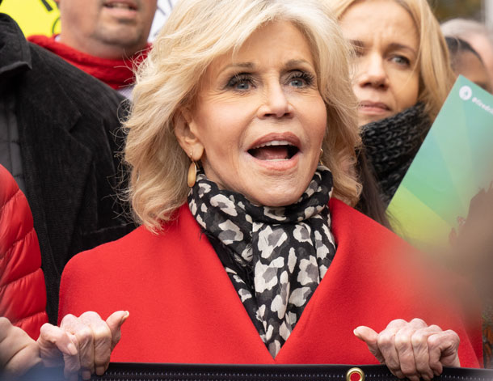
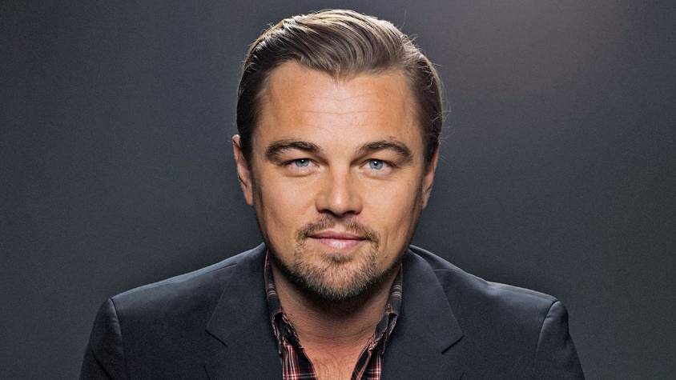
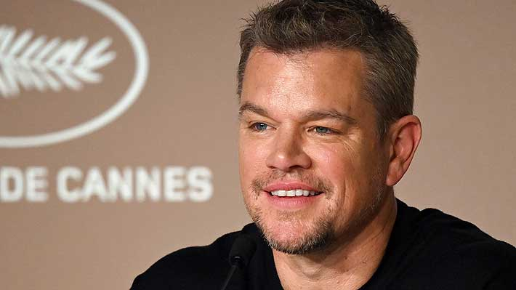
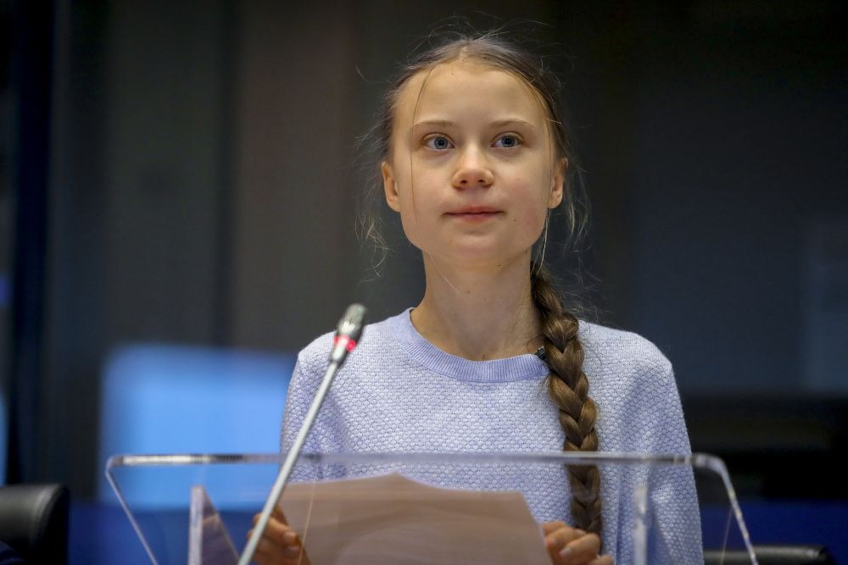
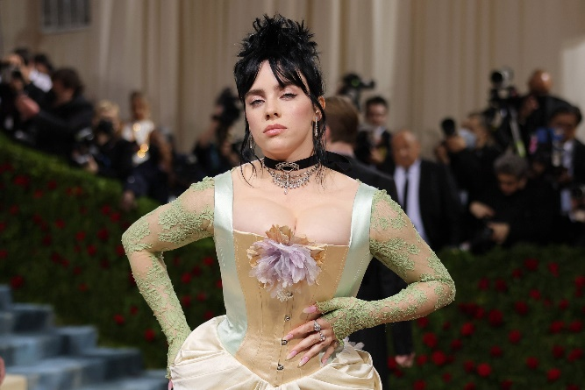
QUIZ TIME!
Connect the name with the person’s photo
and their contribution to the environmental activism

Slide 18
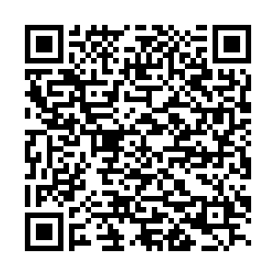

Slide 19
1. Billie Eilish
2. Leonardo di Caprio
3. Sir David Attenborough
4. Jane Fonda
5. Matt Damon
6. Greta Thunberg
a. UN Messenger of Peace for Climate Change
b. Supporter of sustainable fashion
c. Water.org
d. Fire Drill Friday protests
e. Fridays for Future
f. Blue Planet

Slide 20
Inspiring action in Gen Z
Apps and games:
Apps that promote environmental awareness and sustainable living, including zero waste shops, energy consumption trackers, or food recovery programs.
Gamification for education and charity.
Your students are digital experts so let them be your guide and ask them to compile the top 5 ranking of apps that help them live sustainably.
Notes:
https://www.veganfoodandliving.com/features/best-sustainable-apps-smartphone/
https://theecohub.com/sustainability-apps/
https://ozone.unep.org/reset-earth

Slide 21
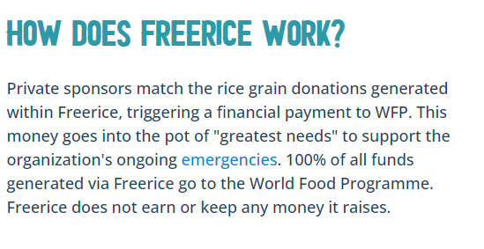

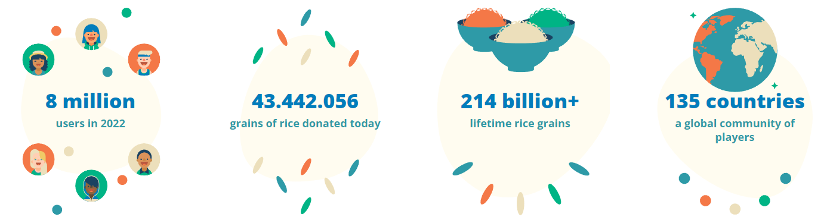
Notes:
https://www.youtube.com/watch?v=zYPofNbr_x4
Freerice game from WFP
Global hunger is one of the most pressing social issues, but it’s also the most solvable. Freerice is a free online educational trivia game where people of all ages can do their part—simply by playing. Every right answer on Freerice triggers a real financial donation to the UN World Food Programme (WFP) from sponsors worth about 10 grains of rice.
The game has five difficulty levels and over 20 categories of questions to choose from, such as English vocabulary, Languages, Science, Humanities, World Landmarks, and a new category called “Coronavirus: Know the Facts.”
Use your time and knowledge to help provide food for people in need. The game is available online at freerice.com or as a free app in the android or iOS app stores.

Slide 22

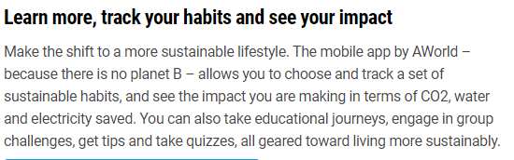
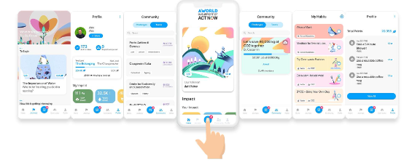
Notes:
ActNow from UN
https://www.un.org/en/actnow
Start with ten impactful actions
Our lifestyles have a profound impact on our planet. Our choices matter. Around two-thirds of global greenhouse gas emissions are linked to private households. The electricity we use, the food we eat, the way we travel, and the things we buy all contribute to a person’s “carbon footprint,” the amount of greenhouse gas emissions associated with an individual’s activities.
Start with these ten actions to help tackle the climate crisis. For more tips, to calculate your carbon footprint and to log your actions, download the app.

Slide 23

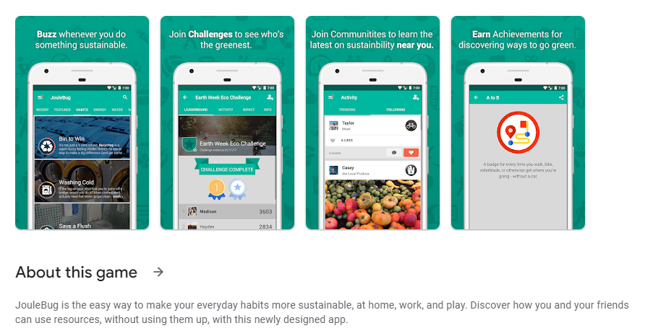

Slide 24
